Slide 1

“A Brief Reprise and
A Blunt Reproof”
6:11 – 18
Week 14
20 April 2022

Slide 2

Galatians Overview
Paul’s concluding remarks include an insight into the motivation behind those seeking to compel circumcision. While such people may seek to glory in the flesh, Paul himself will only glory in the cross of the Lord Jesus Christ (11-14). Summarizing his whole epistle in one verse, Paul reasserts that circumcision is inconsequential, and that in Christ Jesus becoming a new creation is what really matters (15).
With a plea for no one to trouble him since he bears in his body the marks of the Lord Jesus, Paul closes this epistle with a prayer of peace, mercy, and grace upon those who walk according to his teaching, and upon the Israel of God (16-18).

Slide 3
Galatians Introduction
As Paul brought the Galatian letter to a close, he again emphasized some of the great issues discussed throughout the epistle. The conclusion contains both a summary and final statement of the issues the apostle felt so strongly about.
Paul’s last word, written in his own hand rather than by an amanuensis or secretary (11), urges his Galatian friends to keep their focus on Jesus. Neither circumcision nor uncircumcision are relevant to the Christian life. It is all Christ and the new creation believers become in Him.

Slide 4
Galatians Introduction
Paul had written this letter in his own hand, using “large letters” perhaps because of an eye problem mention in Galatians 4:12–20.
The Judaizers, said Paul, were motivated by pride and unwillingness to suffer for Christ. Paul, however, would continue proclaiming the gospel that brought Jews and Gentiles together as “new and different people,” no matter how he might have to suffer because of that sometimes unpopular message.
Paul ended his letter as he had begun it, proclaiming the genuineness of his apostleship . . . compare 6:17 (let no man trouble me) and 1:1(neither by man, but by Jesus Christ).

Slide 5

“A Brief Reprise and
A Blunt Reproof”

Slide 6
Galatians 6:11
¹¹See what large letters I use as I write to you with my own hand!

Slide 7
Galatians 6:11
Throughout the Galatian letter, Paul had been dictating his thoughts to an unnamed amanuensis (secretary). Here, Paul takes pen in hand and conveys his final thoughts with broad, bold strokes.
Undoubtedly, his handwriting toward the end would have verified to the Galatian Christians that this letter was indeed from Paul. Some have suggested he used large letters because of his failing eyesight (cf. 4:15). Or it may have been that Paul’s own penmanship differed from the more refined script of his chosen amanuensis.

Slide 8
Galatians 6:11
Or, in a manner similar to using ALL CAPS TO ACCENTUATE YOUR POINT, Paul may have intended to draw attention to the abrupt change of writers and to emphasize his main argument: Salvation is by grace alone through faith alone in Christ alone, not by the works of the Law.
So, pointing to the cross one last time, Paul sends a final rebuke against the rogue band of pirates who were attempting to hijack the faith of the Galatian Christians. As we examine what Paul has emphasized, we will see that it involves not only a succinct reprise of his argument but also a blunt reproof of the Judaizers.

Slide 9
Galatians 6:12 – 13
¹²Those who want to impress people by means of the flesh are trying to compel you to be circumcised. The only reason they do this is to avoid being persecuted for the cross of Christ. ¹³Not even those who are circumcised keep the law, yet they want you to be circumcised that they may boast about your circumcision in the flesh.

Slide 10
Galatians 6:12 – 13
Paul begins his reprise by readdressing the issue of inward reality versus outward religion. The Judaizers in Galatia had sneaked in to prey on the hearts and minds of the new believers. They compelled them to be circumcised—undergo the rite of initiation into the old-covenant Law—in order to “make a good showing” in the flesh.
Whom were they trying to impress? Paul says they were trying to avoid persecution. At that time, persecution could come from two sources: Jews and Romans. In both cases, retaining the practice of circumcision would help Christians avoid unwanted wrath.

Slide 11
Galatians 6:12 – 13
To the Jews, circumcision would mean that the Gentile Christians were not converting to a competing faith but were willing to submit to the old order of things under the rules, regulation, restrictions, and Rabbis of the long-standing traditions.
To the Romans, who had accepted Judaism as a legal religion in the Roman Empire, Gentiles who were circumcised would fall under the category of Judaism. They would therefore remain under that umbrella of legal toleration. To reject circumcision and take the name “Christian” would mean to sacrifice this protection and potentially face persecution. So, the Judaizers were at least right on that count: Being circumcised would diminish the likelihood of persecution.

Slide 12
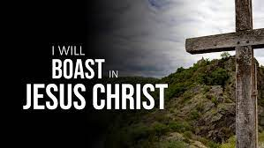

Slide 13
Galatians 6:12 – 13
To do so, however, not only betrayed Christ, who was the Mediator of a new covenant, but also set up a religion that was all show and no substance. Paul says that those who are circumcised “do not even keep the Law themselves” (6:13).
Rather, the Judaizers simply wanted a “get out of persecution free” card and the opportunity to boast about the hard-earned converts to their own distorted, Judaistic Christianity.
Although we’re two millennia removed from the original Judaizers, we’re still tempted to boast in the flesh. We place a notch in our belts when our baptism numbers swell, demonstrating the grand results of our evangelistic efforts.

Slide 14
Galatians 6:12 – 13
We keep close tabs on attendance at services, Sunday school, and special events. This numbers game is one of the most fleshy games congregations can play. Another game we play is the glitz-and-glamour game. The bigger and flashier our Sunday morning productions, the more we feel like we’re worshiped to the max!
But bright lights, loud bands, big budgets, huge crowds, and hyped-up emotional responses mean nothing if they lack real substance. How easy it is to boast in the flesh, focusing on the outward actions rather than the inward reality.

Slide 15
Galatians 6:14 – 16
¹⁴May I never boast except in the cross of our Lord Jesus Christ, through which the world has been crucified to me, and I to the world. ¹⁵Neither circumcision nor uncircumcision means anything; what counts is the new creation. ¹⁶Peace and mercy to all who follow this rule—to the Israel of God.

Slide 16
Galatians 6:14 – 16
In contrast to the Judaizers’ boasting in the visible results of their human efforts, Paul returns to the true center of our boasting: the Cross of the Lord Jesus Christ, the only means of justification and sanctification. Christianity isn’t about our achievements. It’s not about what we can do for God. It’s about what God has done for us.
In fact, a true understanding of the saving work of Jesus Christ on our behalf excludes all boasting in our own merit. Paul makes this clear elsewhere: “For by grace are ye saved through faith; and that not of yourselves: it is the gift of God: ⁹Not of works, lest any man should boast” (Eph 2:8-9).

Slide 17
Galatians 6:14 – 16
God chose us (Eph 1:4). He sent His Son to die for us (Gal 4:4). He gave us a new life we never could have earned(1Pet 1:3). His power and grace alone justified us, sanctify us, and will glorify us. We have nothing to boast about except the person and work of Jesus Christ. Every ounce of credit for who we are and for the hope that we have goes to the Savior who died for us at Calvary.
Besides taking away any basis for personal boasting, the Cross also drew a clear line of division between the believer and the world. This means that the Judaizers’ precarious fence sitting has no place in the Christian life. Previously, Paul was desperately anxious to be in favor with the world. But since his conversion, Paul does not care what the world thinks or says or does.

Slide 18
Galatians 6:14 – 16
This change in perspective has profound practical implications. Like Paul, as Christians, the more we focus on Christ and what He accomplished, the less we’ll focus on the world and what we accomplish. When the Cross becomes everything to us, the world loses its luster.
In fact, all that matters in the Christian life is a “new creation” (6:15). No religious rituals, no acts of devotion, no fleshly merit counts for anything in Christ, who accomplish everything for us. To become children of God, we must become new creatures (2Cor 5:17). The only way to do that is to place our trust in Christ, counting on Him to forgive our sins, make us holy, and present us as righteous before God.

Slide 19
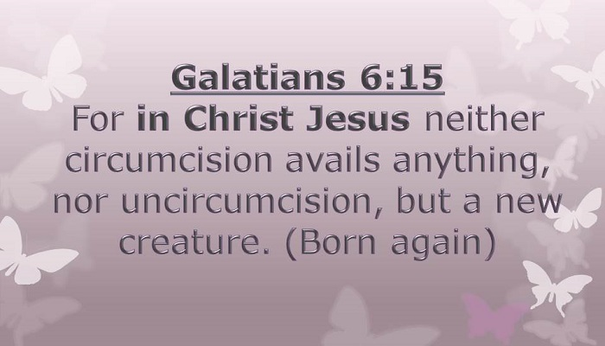

Slide 20
Galatians 6:14 – 16
Paul then says that “those who will walk by this rule”—the principle that the new life is to be lived in the shadow of the Cross—will be granted peace and mercy. Unlike the Law, which produced anxiety and wrath, Gods grace fills a believer’s life with a profound, inexplicable peace and a sense of pardon from sin and its penalties. No longer are we trapped in a dark pit of guilt and fear.
Paul extends this blessing of peace and mercy not only to all those who accept this principle of the Cross but also to “the Israel of God.” Bible students have interpreted this phrase in numerous ways. Some understand it to be a further description of “those who will walk by this rule,” meaning it could be translated, “that is, the Israel of God.”

Slide 21
Galatians 6:14 – 16
In this case, the phrase would refer to all believers in Christ—Jews and Gentiles—as members of “spiritual Israel” in the sense that children of faith are the true children of Abraham (Gal 3:6-9). Others understand “Israel of God” to refer to unbelieving Israel. Here, Paul would be expressing his earnest desire that even the present enemies of the Cross would one day inherit the blessings of peace and mercy (cf. Rom 9:3-4).
Still others see the “Israel of God” as the Jewish Christians who, though true physical members of the nation of Israel, over came the cultural and religious bondage they were in and embraced Jesus as their Messiah, choosing to live according to grace rather than law.

Slide 22
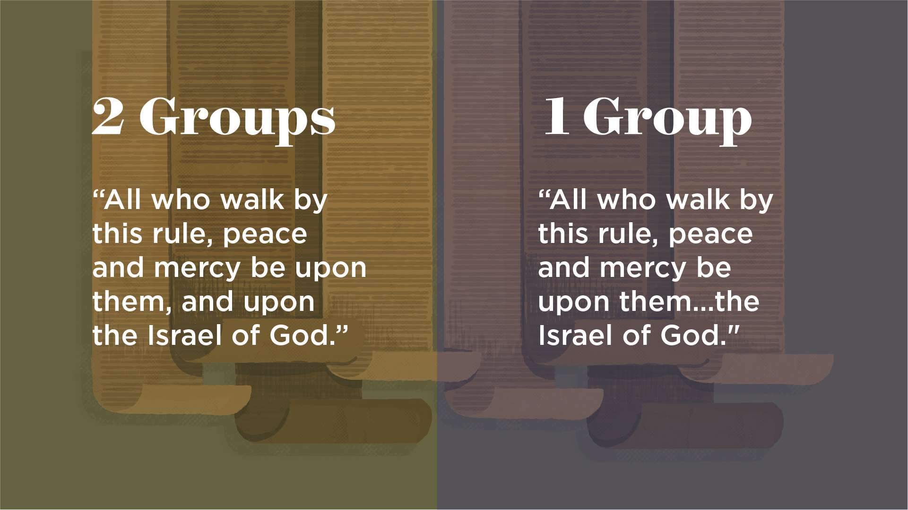

Slide 23
Galatians 6:14 – 16
Paul himself would fit in this category > “Though I also might have confidence in the flesh. If anyone else thinks he may have confidence in the flesh, I more so: circumcised the eighth day, of the stock of Israel, of the tribe of Benjamin, a Hebrew of the Hebrews; concerning the law, a Pharisee; concerning zeal, persecuting the church; concerning the righteousness which is in the law, blameless. But what things were gain to me, these I have counted loss for Christ . . .” (Phil 3:4-11).
Because this is the only place in the Bible where we find the phrase “Israel of God,” we have no way of determining exactly what Paul meant. Yet, the principle still stands—only those who trust in Christ and His redemptive work will receive the peace and mercy for which we all yearn.

Slide 24
Galatians 6:17 – 18
¹⁷From now on, let no one cause me trouble, for I bear on my body the marks of Jesus. ¹⁸The grace of our Lord Jesus Christ be with your spirit, brothers and sisters. Amen.

Slide 25


Slide 26
Galatians 6:17 – 18
As we arrive at the final two verses of Galatians, we find a weary and worn Paul. He writes as if he has exhausted all his energy defending the gospel of grace. Nevertheless, Paul urges the Galatians to no longer allow the legalists to get the upper hand, thus causing him “trouble.”
Paul had surely suffered agony as he worried over the spiritual health of the churches in Galatia and worked hard at composing a letter to free them from the threat of bondage. If they would heed these words, they would relieve him of his anxiety.
Why should the Galatians listen to Paul rather than the Judaizers? Ultimately it came down to the marks of authenticity Paul bore on his own body.

Slide 27
Galatians 6:17 – 18
While the Judaizers promoted the physical mark of circumcision, Paul pointed to the “brand-marks of Jesus.” The Greek word for these marks, “stigmata,” refers to “signs of ownership such as were branded on slaves and cattle.”
Ironically, the very thing the Judaizers were trying to avoid—persecution—Paul regarded as a mark of a true preacher of the gospel. This was in line with Jesus’ own words: “Remember the word that I said to you, ‘A slave is not greater than his master.” If they persecuted Me, they will also persecute you” (John 15:20).

Slide 28
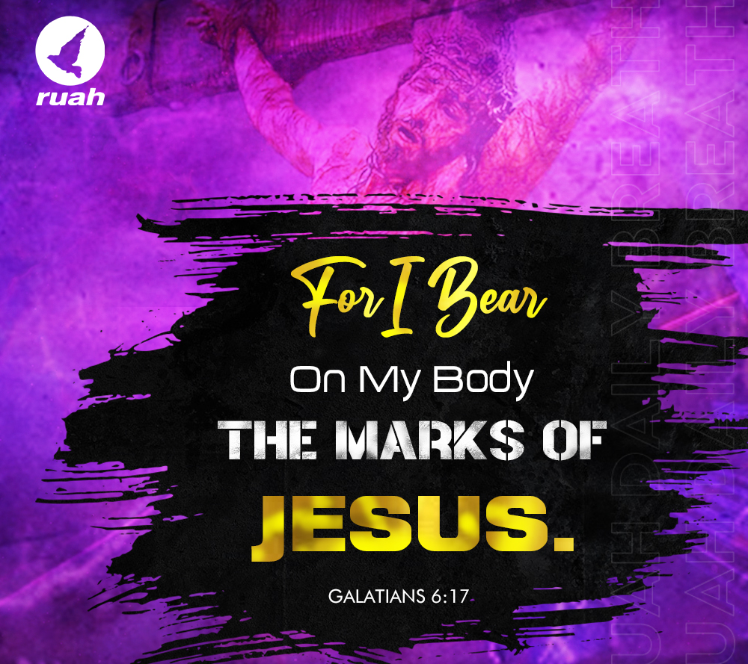
stigmata

Slide 29
Galatians 6:17 – 18
Having fired the final volley against the legalists, Paul concludes his letter on the same note on which he began and around which the whole letter revolves: grace. “The grace of our Lord Jesus Christ be with your spirit, brethren. Amen.”
Grace: lavished on the soul by Christ at the moment of salvation.
Grace: lived out in service to His glory through the sanctifying work of the Spirit.
Grace: the heart and soul of the gospel of Jesus Christ.

Slide 30
Galatians 6:17 – 18
Paul’s passionate appeal to the foundation of the Christian faith (grace), turned his wayward readers back to the path of truth. It can do the same for us when we wander from the liberty of loving service to Christ toward the extremes of legalism or license.
Paul argued that not only is the sinner saved by grace, but the saved sinner also lives by grace. His main message is as relevant for us today as it was for the Galatians in their day: Grace and grace alone is the way to life and the way of life.

Slide 31
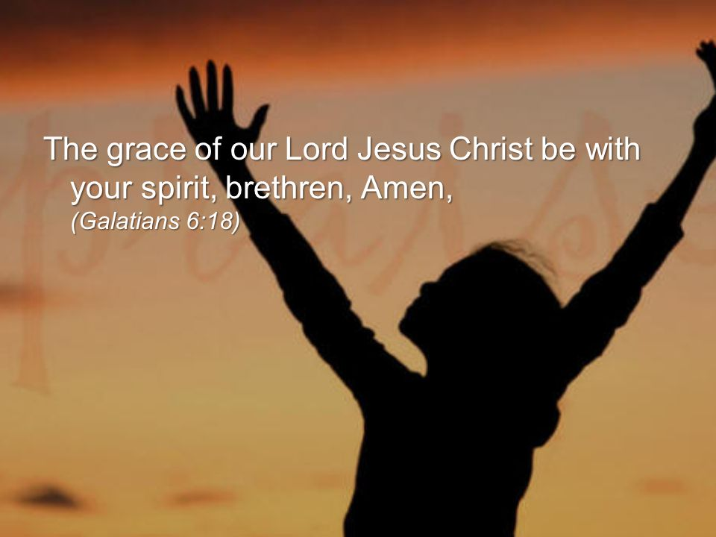

Slide 32
Galatians: application
As we think about the book as a whole, SWINDOLL suggests a few practical principles to apply.
[1] – No one is immune to the temptation of drifting.
  If it could happen to people in the first century who lived under the direct teaching of spiritual leaders like Paul and Barnabas, it can certainly happen to us today.
  The letter of Galatians can serve as a prevailing wind to guide us, keeping us in the safe harbor of grace, and as an anchor to keep us in those calm waters. Read the letter as if Paul was addressing you personally with either a rebuke or a warning.

Slide 33
Galatians: application
As we think about the book as a whole, SWINDOLL suggests a few practical principles to apply.
[2] – Some things are worth fighting for.
  The great news of salvation by grace alone through faith alone in Christ alone is one of those foundation stones of the Christian faith. Like Paul, we need to uphold the true gospel, refuting objections and refusing to compromise.
  Firmly resist the temptation to fudge on the faith. Refuse to change your clear understanding of grace simply to get along or to keep the peace.

Slide 34
Galatians: application
As we think about the book as a whole, SWINDOLL suggests a few practical principles to apply.
[3] – We all began at the same place, which puts us all on the same level.
  We all start out as rebels against God. Through faith in His Son, we become fellow heirs of salvation and inherit the infinite blessings of Christ.
  For unbelievers, Galatians makes God’s plan of salvation clear. For believers, Galatians reminds us that we have no reason to boast about our own salvation or to take credit for our spiritual growth.

Slide 35
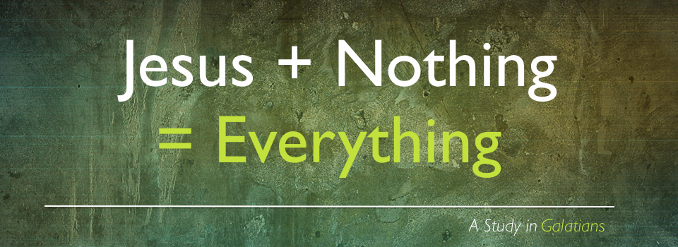

Slide 36



Slide 37
NEXT CLASS – 27 April 2022
Book of Ephesians
Before next class, read the below verses in both the KJV and the NIV . . .
Chapter 1:1 – 14
“Unloading the Theological Truck”
EBC Website for Handouts
https://bit.ly/surveyofpaulineepistles

